Slide 1
MySQL Cluster
[NEC Group Internal Use Only]
OSS Technical Center
NEC Telecom Software Philippines

Slide 4
Revision History
Version No. | Date | Author | Summary
00.01.00 | 2017/08/15 | NSP-pgarcia | Draft version

Slide 5
Table of Contents
Performance Optimization
Overview
Parameter Tuning
thread_cache_size
Connection Pools
Multi-threaded Data Nodes

Slide 6
MySQL Cluster Investigation
Performance Optimization: Parameter Tuning

Slide 7
MySQL Cluster: Performance Optimization
Improving MySQL Cluster performance can be achieved through various means. Access Patterns, AQL (Adaptive Query Localization), Distribution Aware Applications, Batching Operations as well as Alternative APIs are application-level methods can be employed. Hardware too, in particular CPU and Memory, can be upgraded to yield better performance. The DB Schema itself can be optimized by trading a normalized DB structure for performance (Denormalization). Inefficiently designed queries themselves may also lead to poor performance, so identifying the bottlenecks through available MySQL configuration parameters can aid in identifying the causes of the bottleneck or lengthy execution times. These methods, though enumerated, will not be discussed in this investigation report.
Tuning MySQL parameters/configuration settings can also yield better performance. Parameters like thread_cache_size determine the number of threads to pre-generate at Cluster startup – those threads are used to handle the many requests (inserts, updates, queries, etc.) from client connections; when the cache is void of threads and there are still requests, new ones are generated at the cost of some latency or overhead during thread creation. However, it should be considered that too large a thread cache size can unnecessarily consume resources for the lifetime of the Cluster.

Slide 8
MySQL Cluster: Performance Optimization
Threads and Connections
Connection manager threads handle client connection requests on the network interfaces that the server listens to. On all platforms, one manager thread handles TCP/IP connection requests. On Unix, this manager thread also handles Unix socket file connection requests. On Windows, a manager thread handles shared-memory connection requests, and another handles named-pipe connection requests. The server does not create threads to handle interfaces that it does not listen to. For example, a Windows server that does not have support for named-pipe connections enabled does not create a thread to handle them.
By default, connection manager threads associate each client connection with a thread dedicated to it that handles authentication and request processing for that connection. Manager threads create a new thread when necessary but try to avoid doing so by consulting the thread cache first to see whether it contains a thread that can be used for the connection. When a connection ends, its thread is returned to the thread cache if the cache is not full.
In the default connection thread model, there are as many threads as there are clients currently connected, which has some disadvantages when server workload must scale to handle large numbers of connections. For example, thread creation and disposal becomes expensive. Also, each thread requires server and kernel resources, such as stack space. To accommodate a large number of simultaneous connections, the stack size per thread must be kept small, leading to a situation where it is either too small or the server consumes large amounts of memory. Exhaustion of other resources can occur as well, and scheduling overhead can become significant.

Slide 9
MySQL Cluster: Performance Optimization
Parameter Tuning: thread_cache_size
To determine the sufficient number of threads to pre-generate at startup, the following SQL node variables must be considered:
max_connections
Type: global status
The incremental number of connections made to SQL server for the lifetime of the SQL node
threads_created
Type: global status
The incremental number of threads created for the lifetime of the SQL node.
max_used_connections
Type: global status
The highest number of connections to SQL server at a given time for the lifetime of the SQL node
thread_cache_size
Type: session variable
The current size of the thread cache for the lifetime of the SQL node
(default value is [8 + (max_connections / 100)], with max_connections capped at 100)
mysql> show global status like ‘max_connections’;
mysql> show global status like ‘threads_created’;
mysql> show global status like ‘max_used_connections’;
mysql> show session variable like ‘thread_cache_size’;

Slide 10
MySQL Cluster: Performance Optimization
Parameter Tuning: thread_cache_size
When there are fewer connections expected at a given time (simultaneous connections), the effects of thread_cache_size are not significant. However, hundreds of connections at once can noticeably impact system resource consumption, as new threads are generated on the fly.
Although there is no official MySQL reference on the ideal thread_cache_size value, the trigger to increase thread_cache_size is when there are a lot of new connections. This means that the thread_cache_size should be high enough to cater to the anticipated number of (concurrent) connections.
This can also mean that setting the thread_cache_size equal to the value of max_used_connections (which is the highest number of concurrent connections recorded for the lifetime of the SQL node) will not trigger the generation of new threads on the fly, and the associated overhead and latency costs. However, this value will should be increased as max_used_connections increases to keep the optimum performance.

Slide 11
MySQL Cluster: Performance Optimization
Parameter Tuning: thread_cache_size
The value of the thread_cache_size can be set when starting the SQL node, in the configuration file or from within the SQL server itself.
At SQL Node Startup:
In SQL Node Configuration File (my.cnf):
From within SQL server:
Note: this is the only approach that can change the value in real-time, though the value is discarded on shutdown of SQL node
#mysqld --thread-cache-size=<value>
[mysqld]
thread_cache_size=<value>
mysql> set global thread_cache_size=<value> ;

Slide 12
MySQL Cluster Investigation
Performance Optimization: Connection Pools

Slide 13
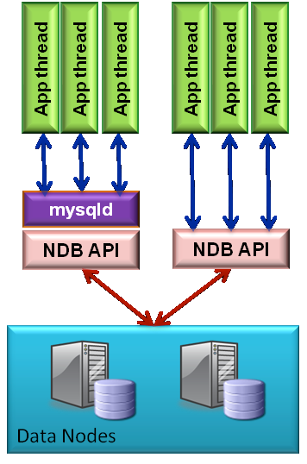
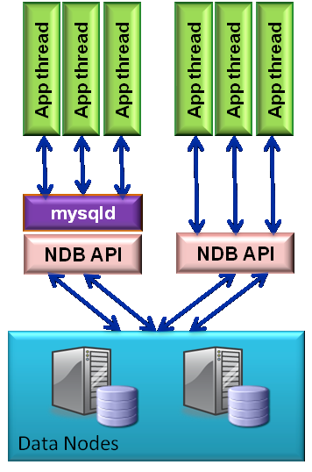
MySQL Cluster: Performance Optimization
Connection Pools
MySQL Cluster can take advantage of a multi-core or multi-CPU (or both) environment with Connection Pools through the ndb-cluster-connection-pool option. By setting this option to a value greater than 1 (the default), a mysqld process (a single SQL node) can use multiple connections to the cluster, effectively mimicking several SQL nodes.
In Figure 1, multiple clients are connected but there is only one NDB API access to the Data Nodes at a time. In Figure 2, Connection Pooling allows for concurrent NDB API access to Data Nodes at a given time, resulting in parallel processing of requests.
Figure 1
Figure 2

Slide 14
MySQL Cluster: Performance Optimization
Connection Pools
To enable Connection Pooling, the option must be set in the configuration file of the MGM node, and in the configuration file of the SQL node or when starting mysqld. Other than a value greater than 1, there is provision of an ideal value for connection pool. However, there are suggestions to use twice the number of CPU’s/Cores on the SQL node host for connection pooling -- with a 2-CPU host, the expected value is 4.
In the MGM Node Configuration File (config.ini), host “host.name” can have up to 4 [mysqld]:
In the SQL Node, it can be set in the Configuration File (my.cnf) or as a parameter of mysqld:
- OR -
[mysqld]
HostName=host.name
[mysqld]
HostName=host.name
[mysqld]
HostName=host.name
[mysqld]
HostName=host.name
[mysqld]
ndb-cluster-connection-pool=4
#mysqld --ndb-cluster-connection-pool=4

Slide 15
MySQL Cluster: Performance Optimization
Connection Pools
This option is useful only when running mysqld on host machines having multiple CPUs, multiple cores, or both. For best results, the value should be smaller than the total number of cores available on the host machine. Setting it to a value greater than this is likely to degrade performance severely.
When ndb-cluster-connection-pool is not set or when the value set is 1, only one instance of the SQL node is started, and all other instances (as set in the MGM node configuration file) are not.
Because each SQL node using connection pooling occupies multiple API node slots—each slot having its own node ID in the cluster—a node ID must not be used as part of the cluster connection string when starting any mysqld process that employs connection pooling.
Setting a node ID in the connection string when using the --ndb-cluster-connection-pool option causes node ID allocation errors when the SQL node attempts to connect to the cluster.

Slide 16
MySQL Cluster Investigation
Performance Optimization: Multi-threaded Data Nodes

Slide 17
MySQL Cluster: Performance Optimization
Multi-threaded Data Nodes
Multi-threaded data nodes add the option of “scaling-up” on larger computer hardware by allowing the data nodes to better exploit multiple CPU cores/threads in a single host. This design maximizes the amount of work that can be performed independently by threads and minimizes their communication.
ndbmtd is the equivalent of ndbd but for multi-threaded data nodes, the process that is used to handle all the data in tables using the MySQL Cluster NDB data node. ndbmtd is intended for use on host computers having multiple CPU cores/threads.
In almost every way, ndbmtd functions in the same manner as ndbd; and the application therefore does not need to be aware of the change. Command-line options and configuration parameters used with ndbd also apply to ndbmtd. ndbmtd is also file system-compatible with ndbd. In other words, a data node running ndbd can be stopped, the binary replaced with ndbmtd, and then restarted without any loss of data. This all makes it extremely simple for developers or administrators to switch to the multi-threaded version.
Multi-threaded Data Nodes also increase the number of available (default) partitions for tables, based on the expected number of LDM (Local Data Manager) Threads (see Figure 3).
It is possible to use ndbd and ndbmtd concurrently on different data nodes in the same MySQL Cluster. However, such configurations have not been tested extensively and is no recommended in a production setting at this time.

Slide 18
MySQL Cluster: Performance Optimization
Multi-threaded Data Nodes
The table below lists the recommended value of MaxNoOfExecutionThreads relative to the number of CPU Cores, as well as the expected number of LDM Threads.
Number of Cores | MaxNoOfExecutionThreads | LDM Threads
2 | 2 | 1
4 | 4 | 2
8 or more | 8 | 4
Figure 3

Slide 19
MySQL Cluster: Performance Optimization
Multi-threaded Data Nodes
To enable multi-threaded data nodes, simply add MaxNoOfExecutionThreads with the appropriate number of threads to be run in the data node, based on the number of threads presented by the processors used in the host or VM (see Figure 3).
In the MGM Node Configuration File (config.ini), MaxNoOfExecutionThreads must be set under [ndbd default]:
In all Data Nodes, start the ndbmtd (not ndbd) process:
[ndbd default]
MaxNoOfExecutionThreads=<MaxNoOfExecutionThreads>
#ndbmtd

